Slide 1
Accessing Healthcare Databases with Python
Notes:
CLICK 1 <Hello. In this video, you will learn how to access databases using Python.
Databases are powerful tools for data scientists.
After completing this module, you can explain the basic concepts of using Python to connect to databases. >

Slide 2
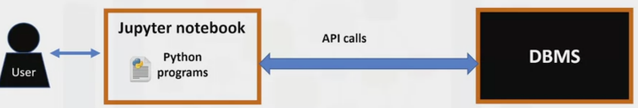
Accessing databases using Python
Notes:
CLICK 1 <This is how a typical user accesses databases using Python code written on a Jupyter notebook, a web-based editor.
There is a mechanism by which the Python program communicates with the DBMS.
The Python code connects to the database using API calls. We will explain the basics of SQL APIs and Python DB APIs. >

Slide 3
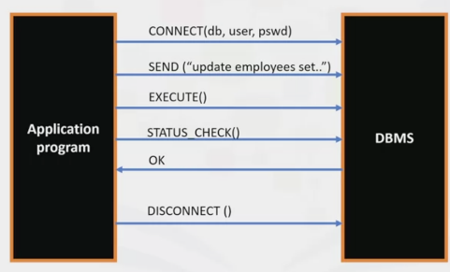
What is a SQL API?
Notes:
CLICK 1 <An application programming interface is a set of functions you can call to access some service.
The SQL API consists of library function calls as an application programming interface, API, for the DBMS.
To pass SQL statements to the DBMS, an application program calls functions in the API, and it reaches other procedures to retrieve query results and status information from the DBMS.
The essential operation of a typical SQL API is illustrated in the figure. The application program begins its database access with one or more API calls that connect the program to the DBMS.
To send the SQL statement to the DBMS, the program builds the statement as a text string in a buffer and then makes an API call to pass the buffer contents to the DBMS.
The application program makes API calls to check its DBMS request's status and handle errors. The application program ends its database access with an API call that disconnects it from the database. >

Slide 4
What is a DB-API?

Slide 5
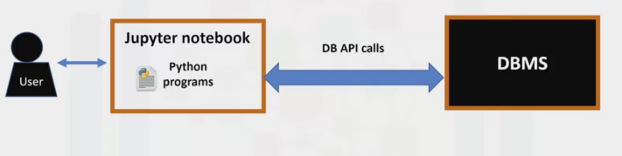
What is a DB-APl?
Notes:
CLICK 1 <So, if you learn the DB-API functions, you can apply that knowledge to use any database with Python.>

Slide 6
Concepts of the Python DB API
Connection Objects
Database connections
Manage transactions
Cursor Objects
Database Queries
Notes:
CLICK 1 <The two main concepts in the Python DB-API are connection objects and query objects.>
CLICK 2 <You use connection objects to connect to a database and manage your transactions.
Cursor objects are used to run queries. >
CLICK 3 <You open a cursor object and then run queries. The cursor works similarly to a cursor in a text processing system where you scroll down your result set and gets your data into the application. Cursors are used to scan through the results of a database. >

Slide 7
What are Connection methods?
cursor()
• commit()
• rollback()
• close()
Notes:
CLICK 1 <Here are the methods used with connection objects.>
CLICK 2 <The cursor() method returns a new cursor object using the connection. >
CLICK 3 <The commit() method commits any pending transaction to the database. >
CLICK 4< The rollback() method causes the database to roll back to the start of any pending transaction. >
CLICK 5 <The close() method closes a database connection. >

Slide 8
Writing code using DB-API
from dbmodule import connect
#Create connection object
tion = connect ('databasename', 'username', 'pswd’)
#Create a cursor object
cursor = connectioncursor. ()
#Run queries
cursor.execute('select * from mytable’)
results = cursor.fetchall()
#Free resources
Cursor.close()
connection.close()
Notes:
CLICK 1 <Let's walk through a Python application that uses the DB-API to query a database. >
CLICK 2 <First, you import your database module using the connect API from that module.
CLICK 3 <To open a connection to the database, you use the connection function and pass in the
parameters: the database name, username, and password. >
CLICK 4 <The connect function returns the connection object.
After this, you create a cursor object on the connection object. >
CLICK 5 <The cursor is used to run queries and fetch results. After running the queries using the cursor, we also use the cursor to fetch the query results. >
CLICK 6 <Finally, when the system is done running the queries, it frees all resources by closing
the connection.>

Slide 9

IBM Developer
Notes:
CLICE 1 <You just saw the steps needed to create a DataFrame, and then export that DataFrame to a CSV file. You may face an opposite scenario in which you must import a CSV into Python. If that’s the case, you can check out this course that explains how to import a CSV file into Python using Pandas.
You may also want to check the Pandas Documentation for further information about using ‘to_csv’.>

